Slide 1
Year 11 –
Stoichiometry Test Results

Slide 2
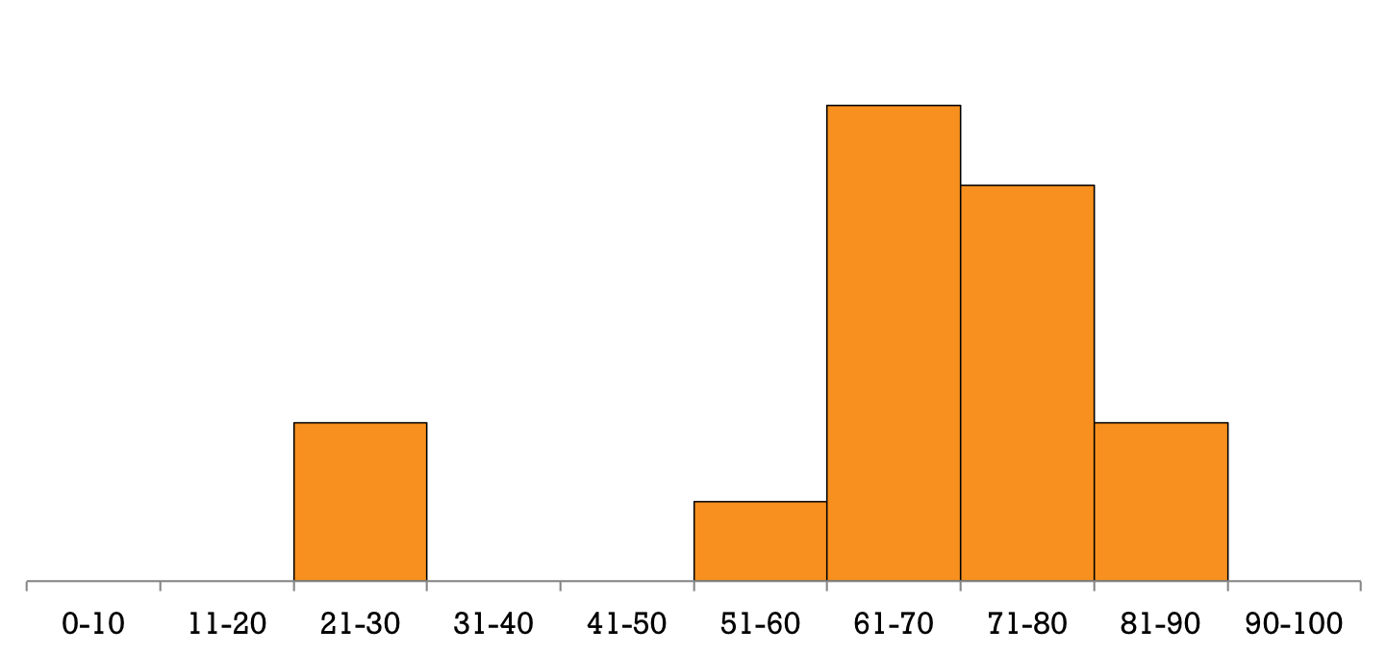
The Stats
Mean: 64%
Median: 69%

Slide 3
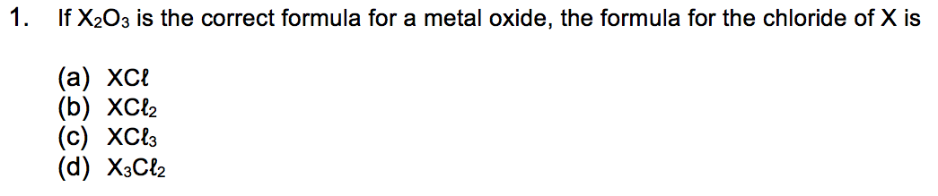
MC Q1
Answer: C
Logic:
  If the formula is X₂O₃ then X must be X³⁺
  X³⁺ and Cl⁻ would form compound XCl₃

Slide 4
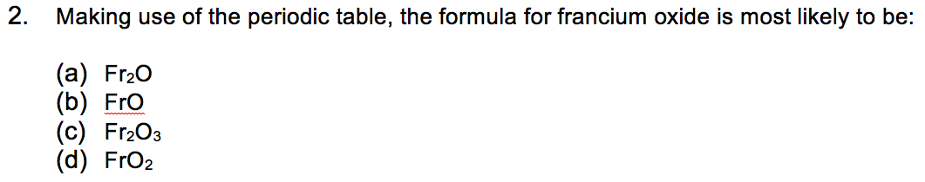
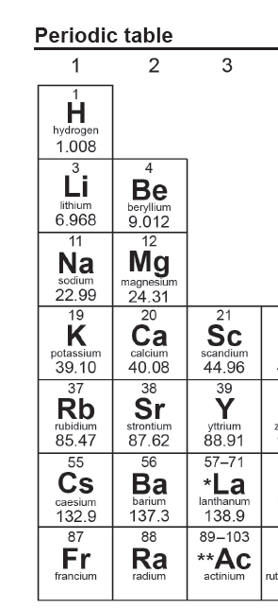
MC Q2
Answer: A
Logic:
  Ions in Group 1 form a +1 charge
  Fr⁺ and O²⁻ would form Fr₂O

Slide 5
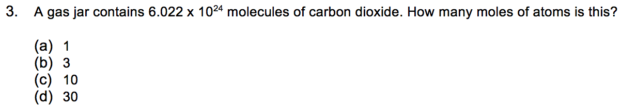
MC Q3
Answer: D
Logic:
  1 mole is 6.022 x 10²³ items
  There are 10 moles of CO₂ molecules
  Each molecule contains 3 atoms
  Therefore there are 30 moles of atoms

Slide 6
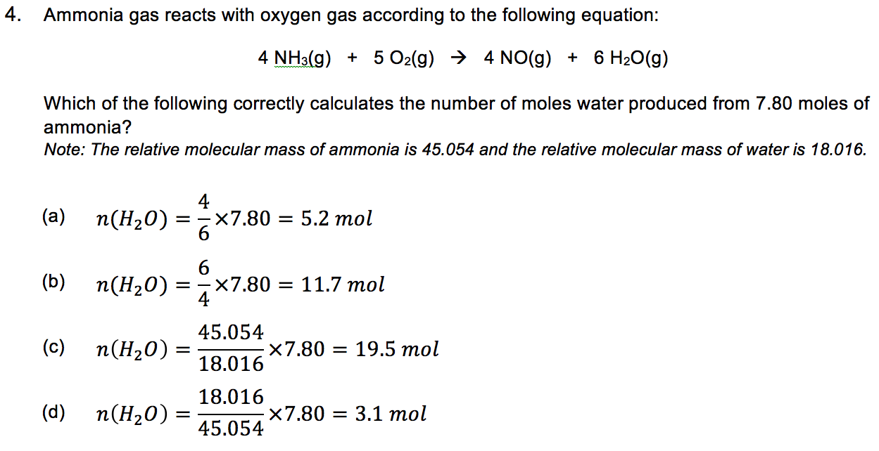
MC Q4
Answer: B
Logic:
  Balanced equation tells you ratio of moles
  6 moles of water are produced from 4 moles of NH₃
  Therefore n(H₂O) = 6/4 x n(NH₃)
  Relative molecular masses were irrelevant for this question

Slide 7
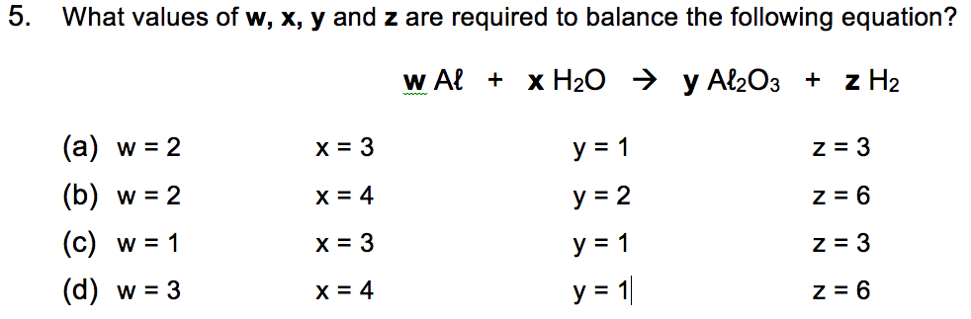
MC Q5
Answer: A
Logic:
  W must be 2 to balance number of Al atoms
  X must be 3 to balance number of O atoms

Slide 8
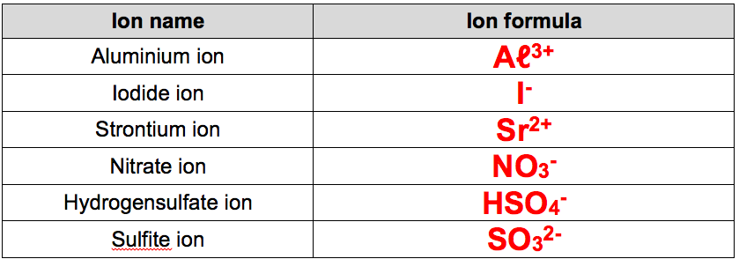
SA Q1
Each answer was worth 1% in this test
People who learnt their ions should have received a free 6% here

Slide 9
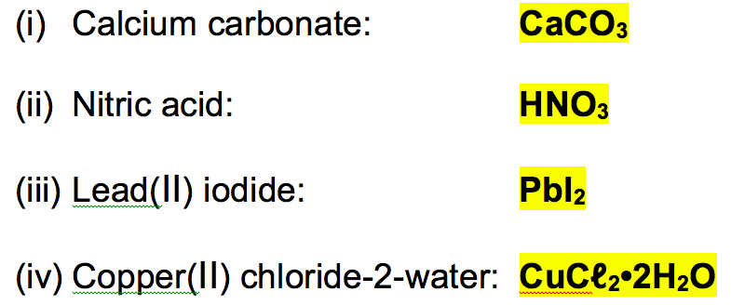
SA Q2
Each answer was worth 2% in this test

Slide 10
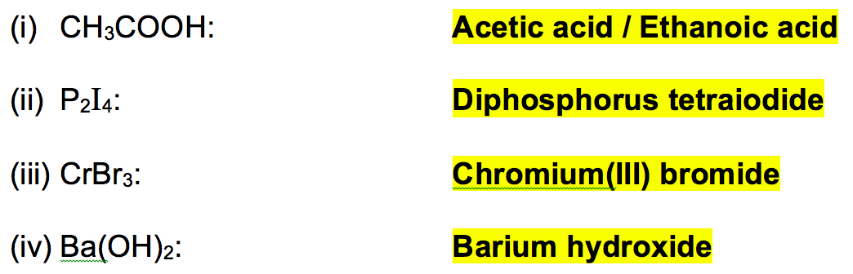
SA Q2
Each answer was worth 2% in this test

Slide 11
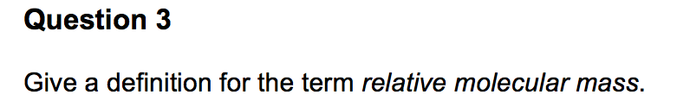
SA Q3
Answer:
  Mass of a molecule relative to 1/12th of a carbon-12 atom
  (OR: Sum of relative atomic masses of all atoms in a molecule)

Slide 12
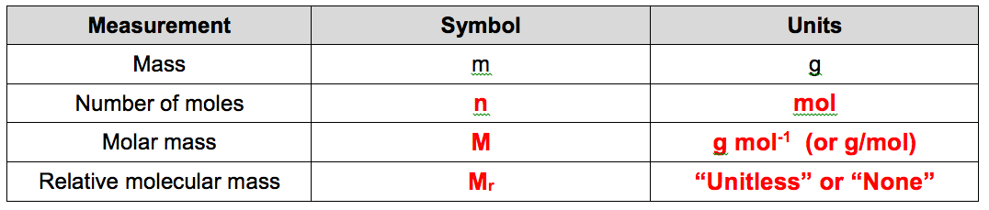
SA Q4

Slide 13
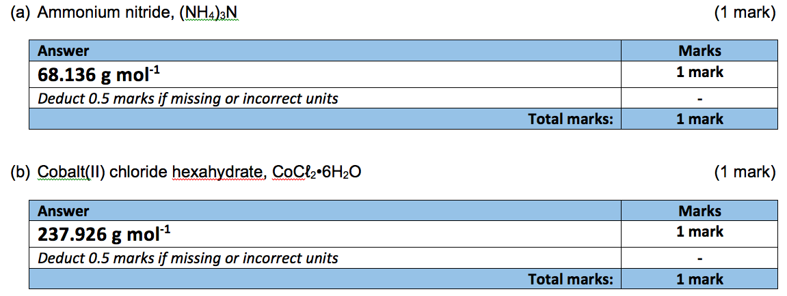
SA Q5

Slide 14
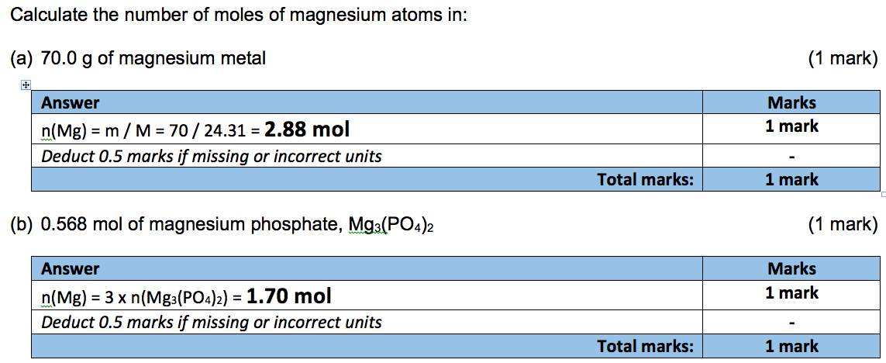
SA Q6

Slide 15
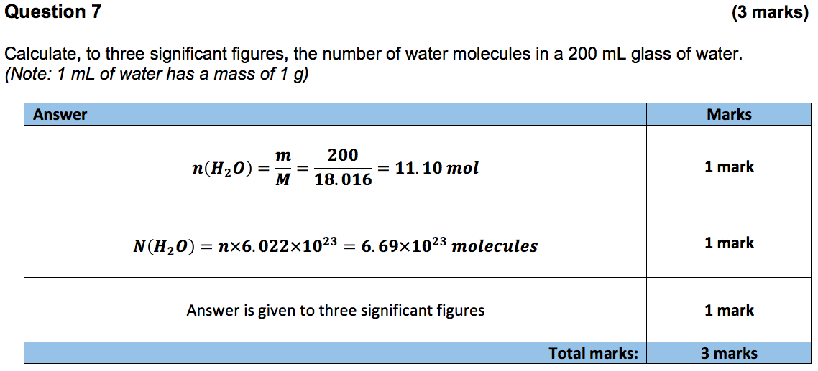
SA Q7

Slide 16
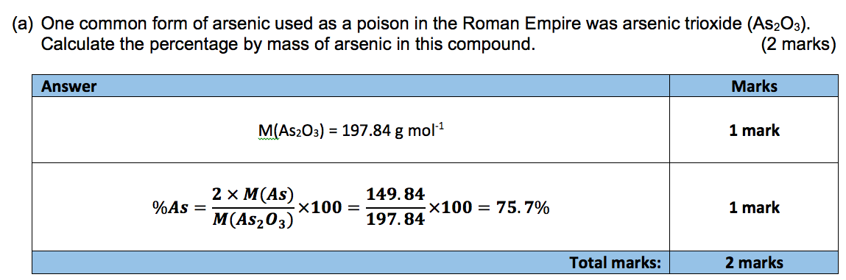
SA Q8a

Slide 17
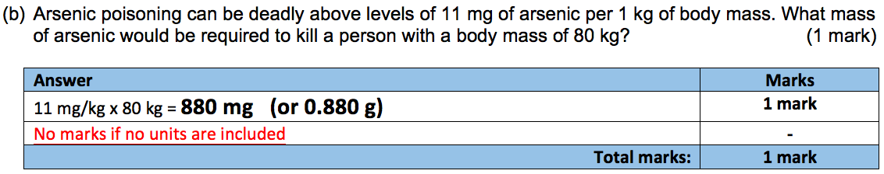
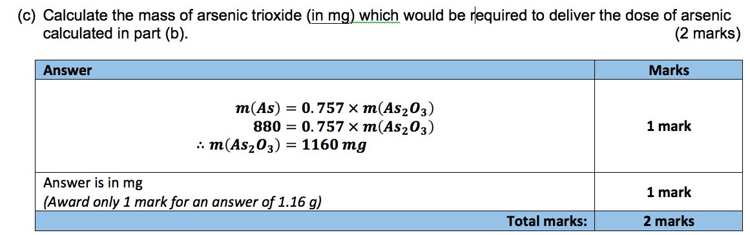
SA Q8b & c

Slide 18
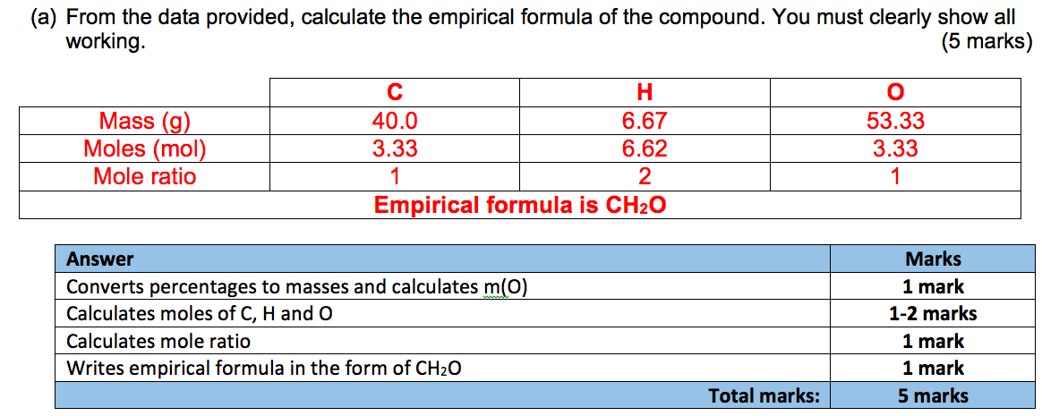
SA Q9a

Slide 19
SA Q9b
M(CH₂O) ≈ 30 g mol⁻¹
M(compound) ≈ 180 g mol⁻¹
180 / 30 = 6,
∴ molecular formula is 6x empirical formula
Molecular formula is C₆H₁₂O₆

Slide 20
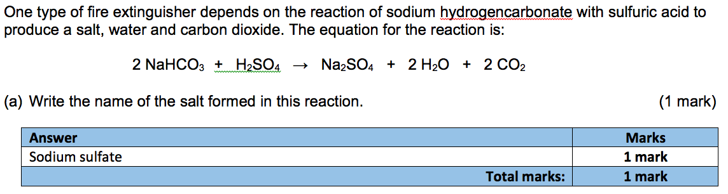
SA Q10a

Slide 21
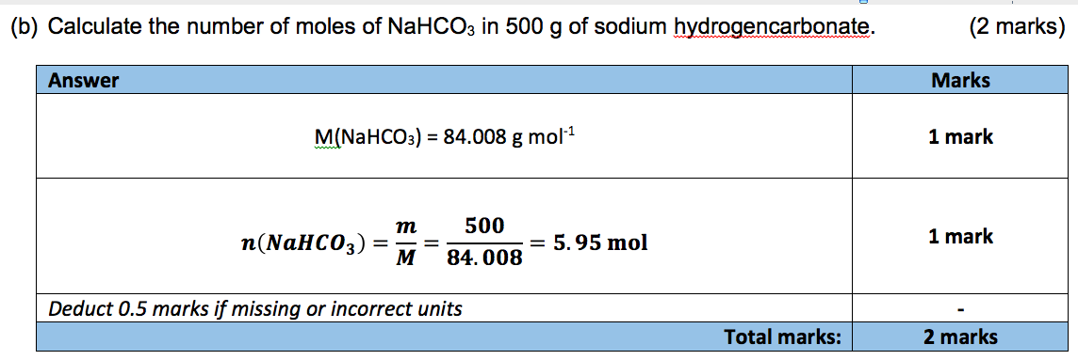
SA Q10b

Slide 22
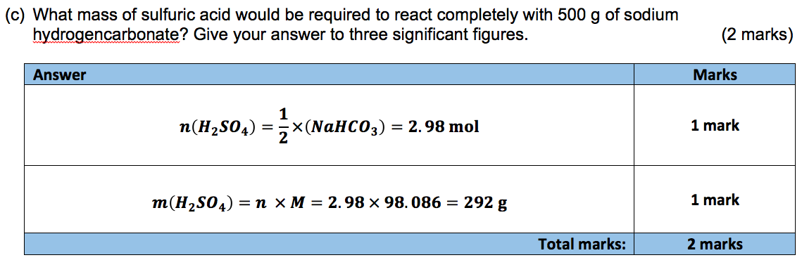
SA Q10c

Slide 23
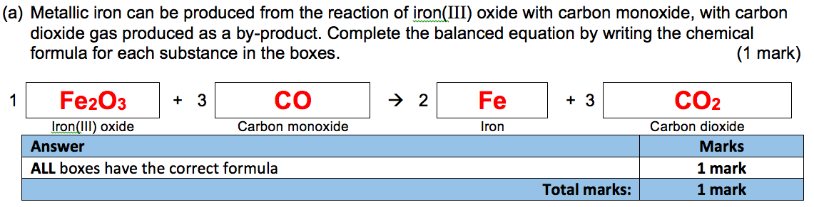
SA Q11a

Slide 24
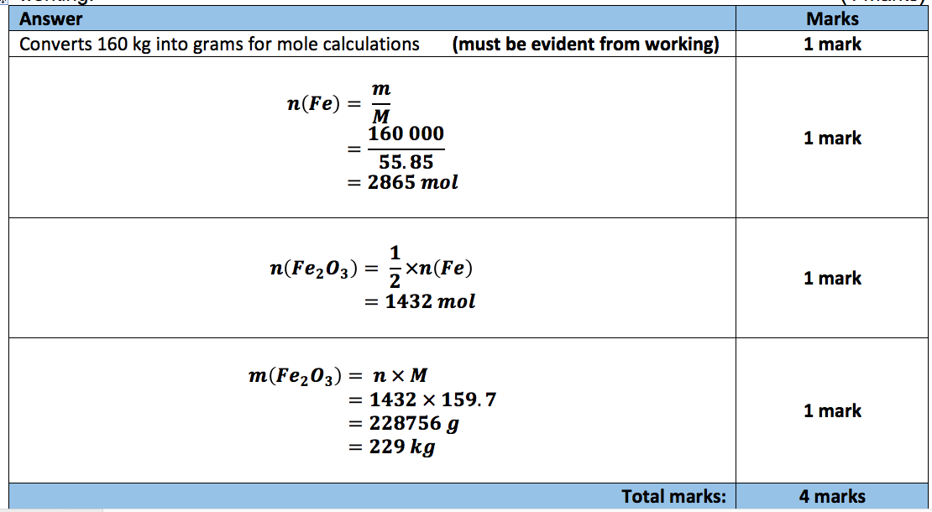
SA Q11b

Slide 25
Moving onwards
Every test from now on will contain at least one major (5-10 mark) calculation question
Next test: Week 6/7
  Chapter 1 (Atoms & Elements)
  Chapter 2 (Classifying and Separating Substances)
First assignment:
  Applications of GC-MS and AAS
  To be given out later this week
  Due date TBC

